Slide 1

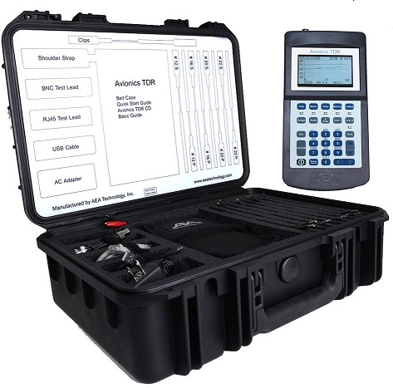
Avionics TDR
January 24, 2012
Revised 09/01/2020

Slide 2
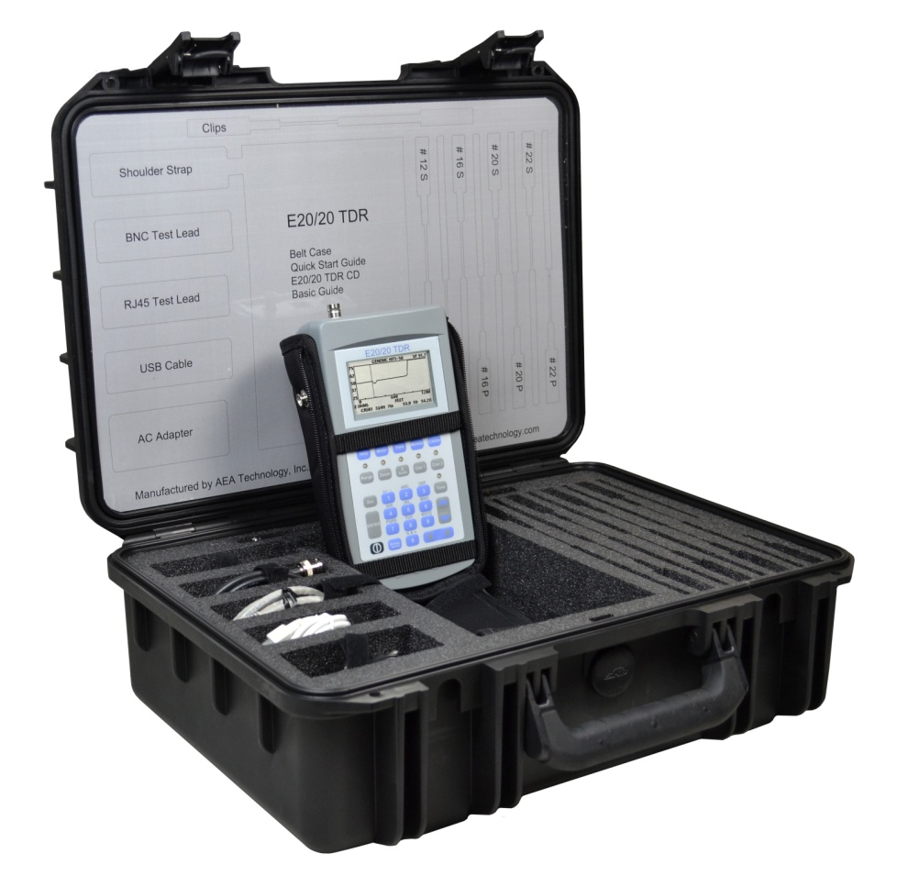

Avionics Kit Carrying Case
Customized Carrying Case
Anti-FOD design
1. Retention for all components
2. Lid label for contents ID
ATA 300 Category 1 rating
MIL-STD 810F Impact Damage,
UV, Solvents, and Anti-fungus
MIL-STD C4150J Waterproof and
Dust Tightness
MIL-STC 648C Ambient
Pressure Equalization
3

Slide 3
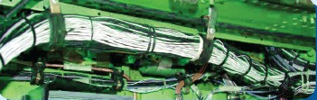
Single-wires in a Harness Impedance
Harness
Cross-section
General Rules:
More wires in the harness the lower
the overall impedance ~80-100 Ohms
2. Less wires in the harness the higher
the overall impedance ~150-200 Ohms
3. Closer the wires in the harness the
lower their impedance
Further away the wires are in a harness
the higher their impedance
Rules apply to any single-wire in the
  harness and the airframe
Airframe
All single-wires are
capacitively coupled
creating the harness’
impedance
23

Slide 4
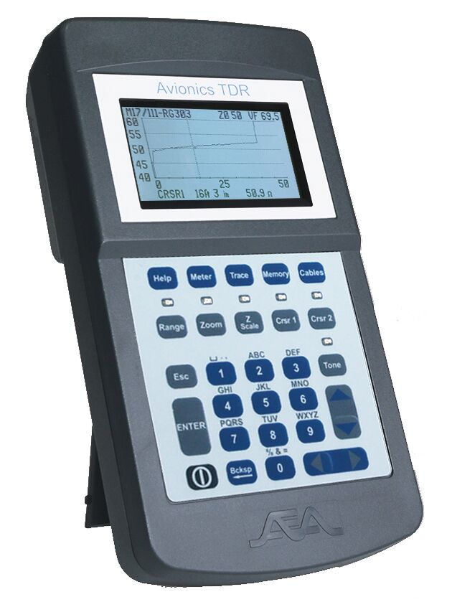
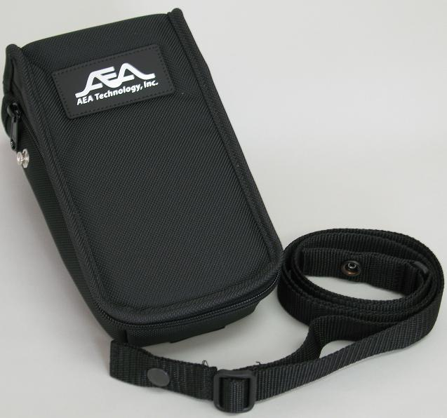
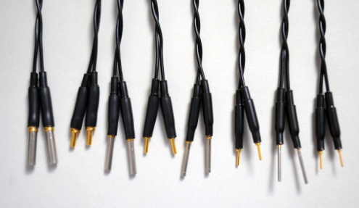
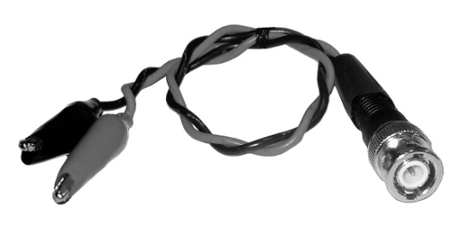
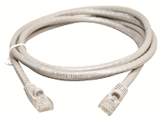
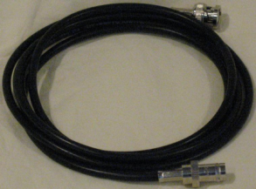
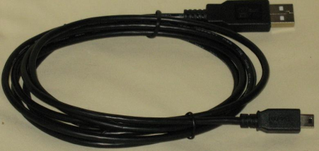
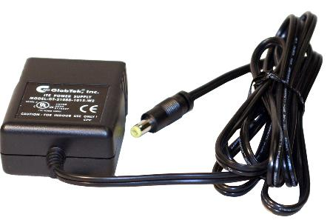
Avionics TDR Kit Included Accessories
BNC- to- #12, 16, 20, & 22
Pins & Socket Test Leads
Padded Belt Case
Avionics TDR
USB Cable
A-to-Mini B
BNC-to-Alligator Leads
RJ-45 Test Lead
6 ft (2m)
BNC Coax Lead
6 ft (2m)
4
AC Power Adapter

Slide 5
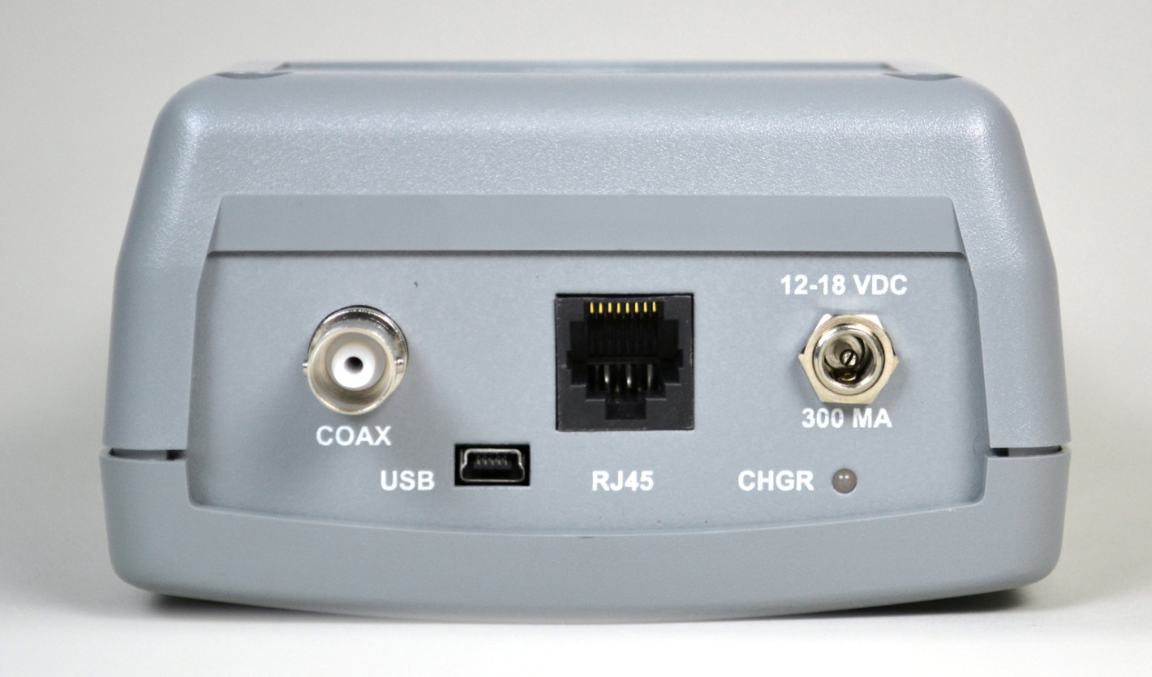
Avionics TDR Layout
Quarter VGA backlit display
High tactile feel & weather resistant
keypad with Function Key LEDs
BNC & RJ-45 Test Ports
Avionics TDR Top End
DC Input
power jack
Rugged ABS plastic case with
prop stand on the back
USB-2 Mini Port
BNC Connector
9

Slide 6
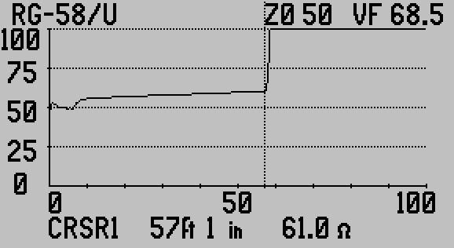
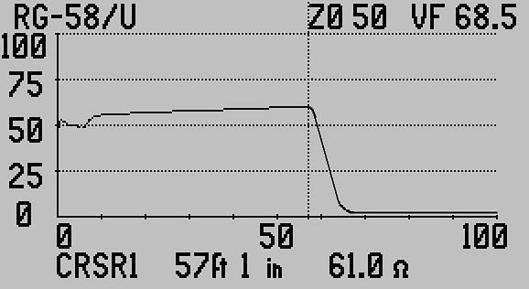
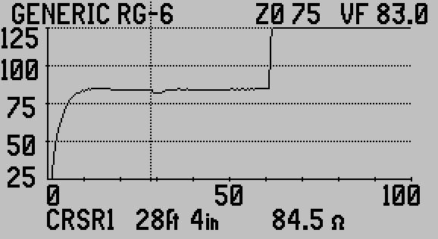
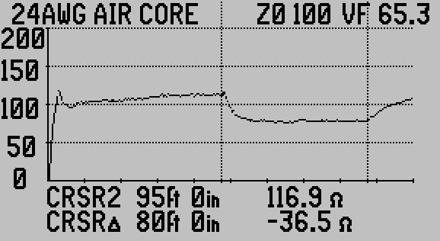
Example TDR Traces
Open Coax
Shorted Coax
Pinched Coax
Wet Cable
21

Slide 7
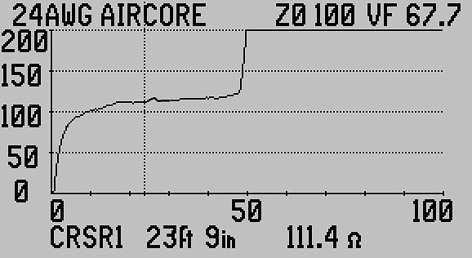

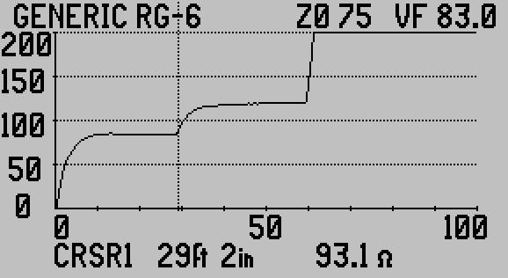
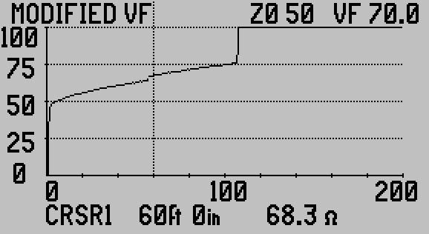
Example TDR Traces
Good Splice
Bad Splice
Series Resistive Fault
Coax Shield Fault
22

Slide 8
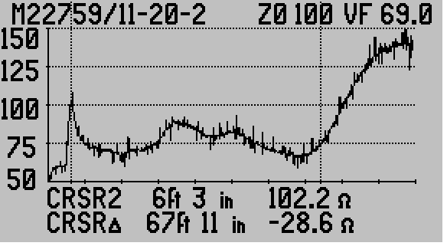
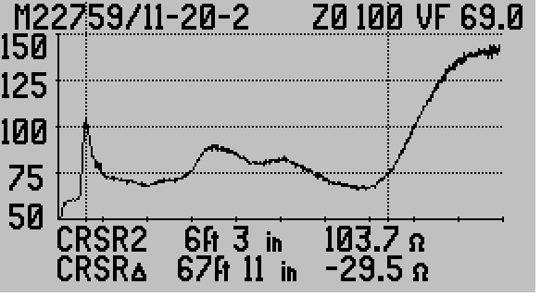
Example Avionics TDR Traces
Single-wires in harness
Single-wires in harness
Noise filter OFF
Same wires
Noise filter ON
25

Slide 9
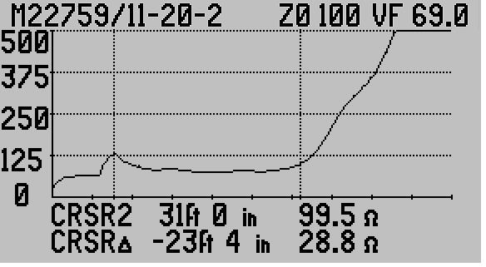
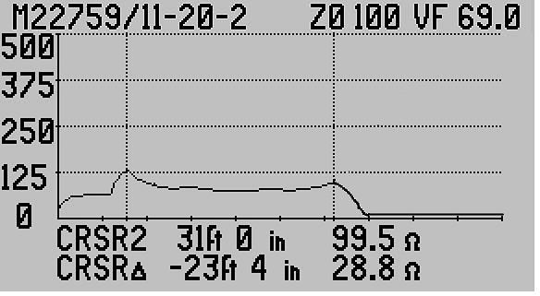
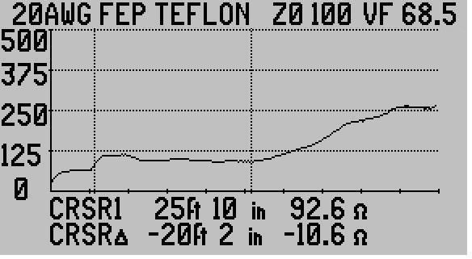
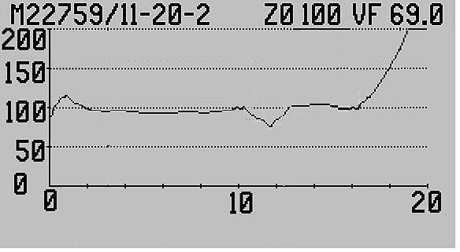
Example Single-wires in a Harness Traces
Single-wire to airframe open
Single-wire to airframe shorted
Single-wires in harness
Single-wires with fault @ 10ft
24

Slide 10
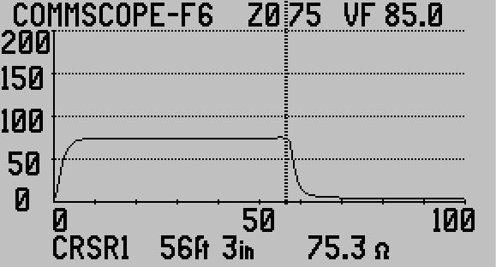
Measurement Screen
Cable Type,
Impedance, &
Velocity
1 of 2
Cursors
Impedance
Scale
Plot Range
Blinking Low
Battery indicator
(~20 minutes
power remaining)
Cursor Data – Feet, Inches or Meters and Impedance
20

Slide 11
ETDR PC VisionTM Software
Operating Systems: Windows 7® , Win 8.0 or 8.1® , Win 10®
No platform license – Load on any number of PC’s
Upload saved or current traces to the PC
Archive the traces on the PC or other memory media
Upload and Download Cable Lists to the Avionics TDR
Upload and Download instrument setups to the Avionics TDR
48

Slide 12
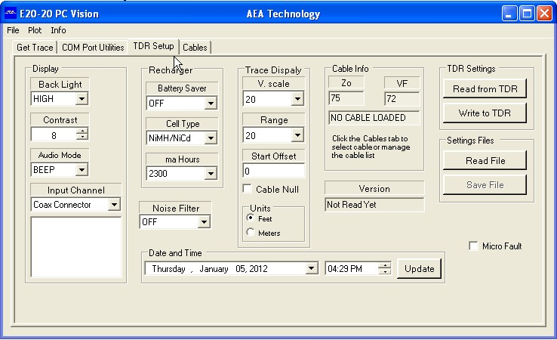
Setup Tab
Press either
to obtain
valid data
(gray text is
not valid)
54

Slide 13
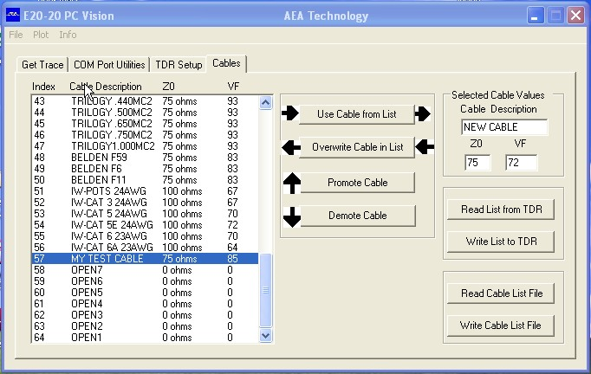
Cables Tab
Read the Cable
List from TDR
or from a
stored list on the
PC
Write the Cable
List to the TDR
or to a stored list
on the PC
Use these keys and “Select Cable Values” to edit the list
55

Slide 14
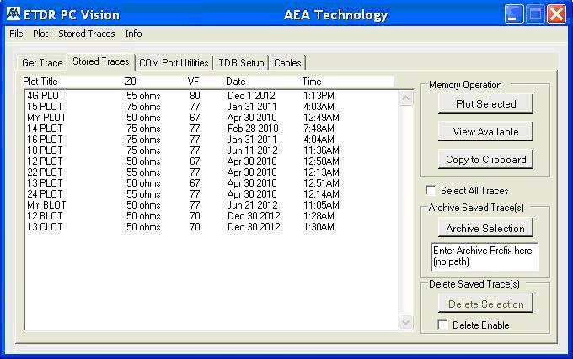
Stored Traces Tab
ANTENNA 2 50 78.6 12/30/11 11:58
ANTENNA 5 50 78.6 12/30/11 12:26
CON. 401 100 67.7 1/3/12 07:39
CON. 331 100 67.7 1/3/12 08:38
SENSOR 6-1 100 72.3 1/5/12 09:11
SENSOR 6-2 100 72.3 1/5/12 09:15
FLIR 1 75 74.8 1/10/12 10:27
Press first to
upload a list
of stored
traces
Direct save TDR
memory to PC
folder
Caution – There is NO UNDELETE
52

Slide 15
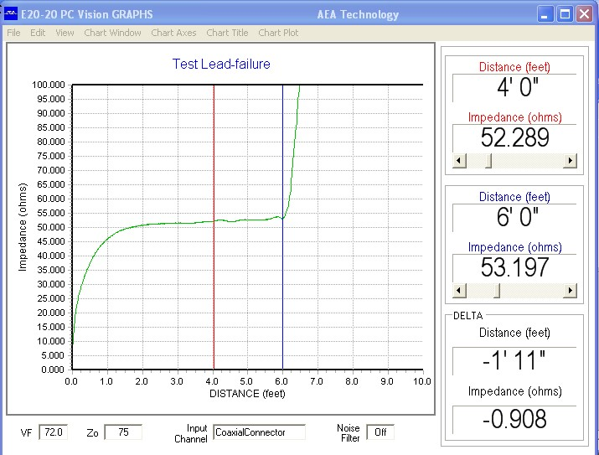
Graphic Plot Screen
53

